Slide 1



Inclusion & Diversity in Open Source Projects
opensourcediversity.org
@osdiversity #opensourcediversity

Slide 2
1 – 11 %
Notes:
Anywhere between 1-11% is what studies find for participation of women in open source
According to a study by National Science Foundation in 2004 [Women, Minorities, and Persons with Disabilities in Science and Engineering] 28% of employees with computer and mathematical occupations are female

Slide 3
GitHub Open Source Survey
95% of respondents are men
just 3% are women
Notes:
http://opensourcesurvey.org/2017/

Slide 4
Half of contributors say that their open source work was somewhat or very important in getting their current role. Open source work helps people build their professional reputation.
Improving contributor representation can help create a more representative tech sector overall.
GitHub Open Source Survey 2017
Notes:
http://opensourcesurvey.org/2017/

Slide 5
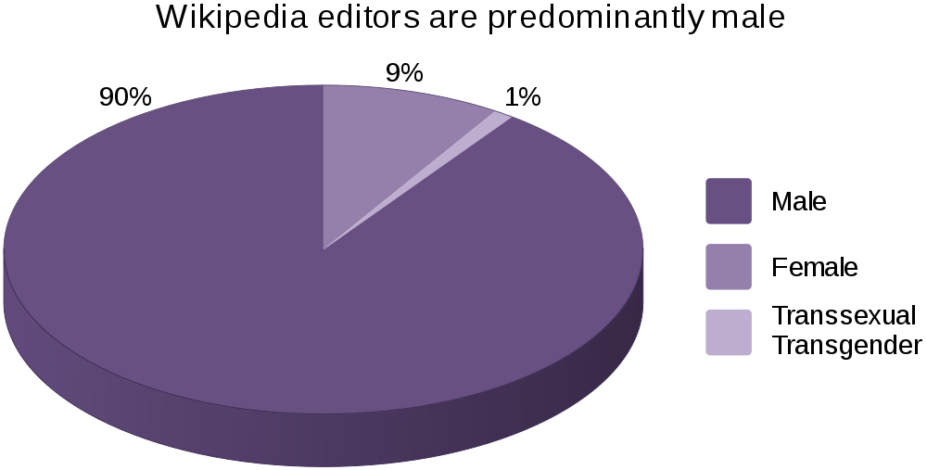
Wikipedia
Wikipedia: Gender bias on Wikipedia
Notes:
https://en.wikipedia.org/wiki/Gender_bias_on_Wikipedia

Slide 6
Wikipedia content suffers from the bias of its editors: mainly technically inclined, English-speaking, white-collar men living in majority-Christian, developed countries in the Northern hemisphere.
Wikipedia: Racial bias on Wikipedia
Notes:
https://en.wikipedia.org/wiki/Racial_bias_on_Wikipedia

Slide 7
Gender identity
Sexual orientation
Ethnicity
Ability
Age
Even skill level or technical affinity
Notes:
… and that leaves out plenty of people

Slide 8
Diverse teams work better
Harvard Business Review McKinsey Stanford Business Inc.com
Notes:
Lots of studies conclude the positive impact a diverse team has on innovation and the bottom line
https://hbr.org/2016/11/why-diverse-teams-are-smarter
https://www.mckinsey.com/business-functions/organization/our-insights/why-diversity-matters
https://www.gsb.stanford.edu/insights/diverse-backgrounds-personalities-can-strengthen-groups
https://www.inc.com/adam-vaccaro/diversity-and-performance.html

Slide 9
How we can improve

Slide 10
Rudeness
45% witnessed, 16% experienced
Name calling
20% witnessed, 5% experienced
Unwelcoming language or content
women 25%, men 15%
GitHub Open Source Survey 2017
Notes:
http://opensourcesurvey.org/2017/
Stereotyping men: 2% women: 12%
Unsolicited sexual advances m: 3% w: 6%

Slide 11
21% of people
who experienced negative behavior
stopped contributing to the project
GitHub Open Source Survey 2017
Notes:
http://opensourcesurvey.org/2017/

Slide 12

Code of Conduct
Contributor Covenant

Slide 13
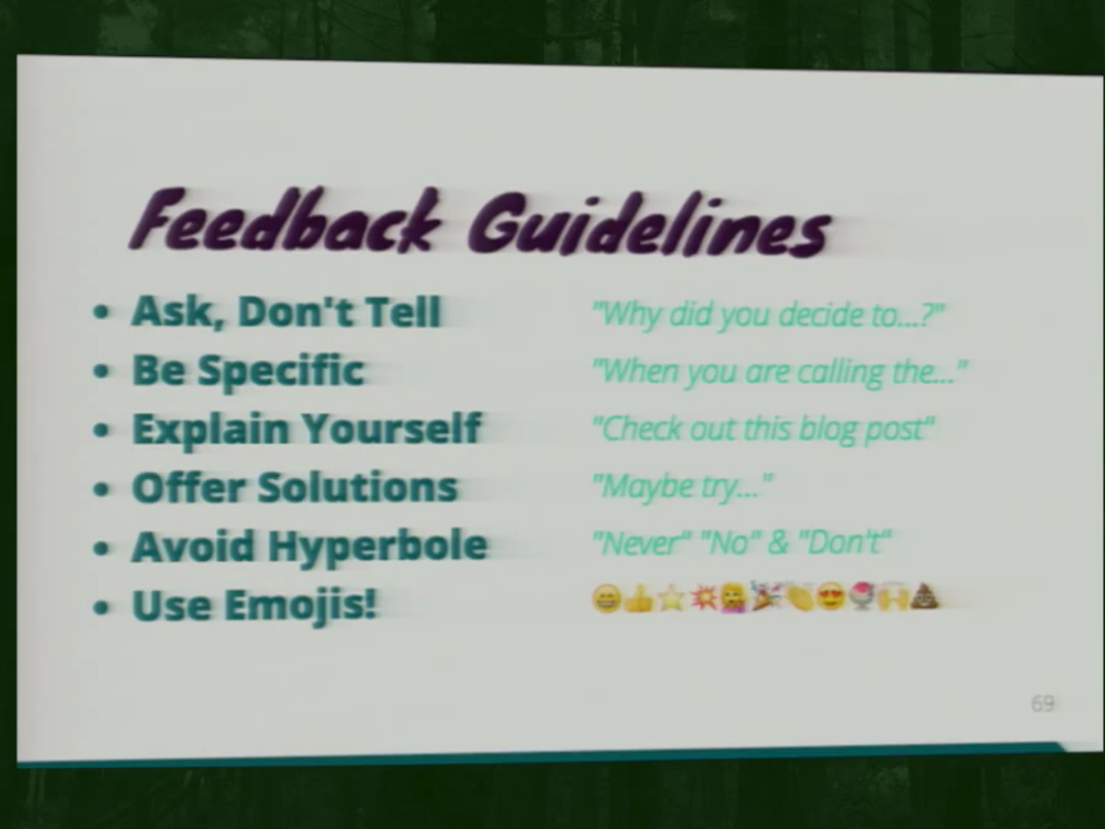
Una Kravets at CascadiaFest
Notes:
This is a talk about getting designers involved – so people usually not familiar with open source, and also not so represented. A lot of the recommendations are also true for getting people of underrepresented groups involved.
http://2015.cascadiajs.com/speakers/una-kravets

Slide 14
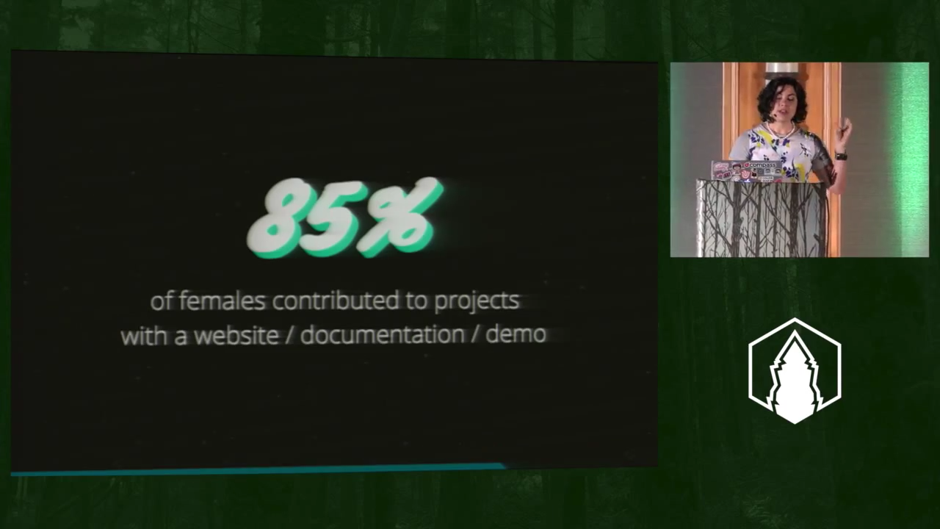
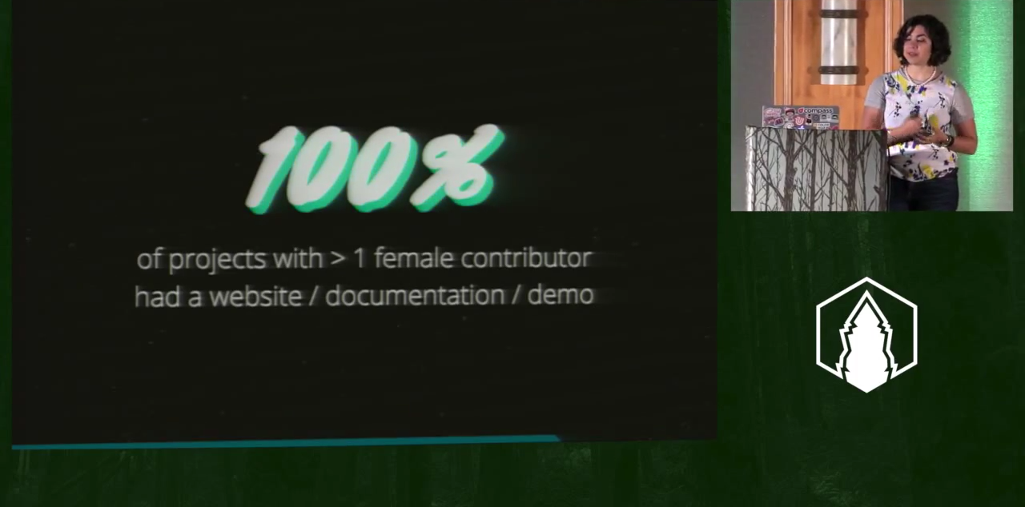
Una Kravets at CascadiaFest
Una Kravets at CascadiaFest
Notes:
Una also mentioned that 100% of projects with at least 1 female contributor had a website/documentation/demo.
Documentation increases Diversity increases Documentation!
http://2015.cascadiajs.com/speakers/una-kravets

Slide 15
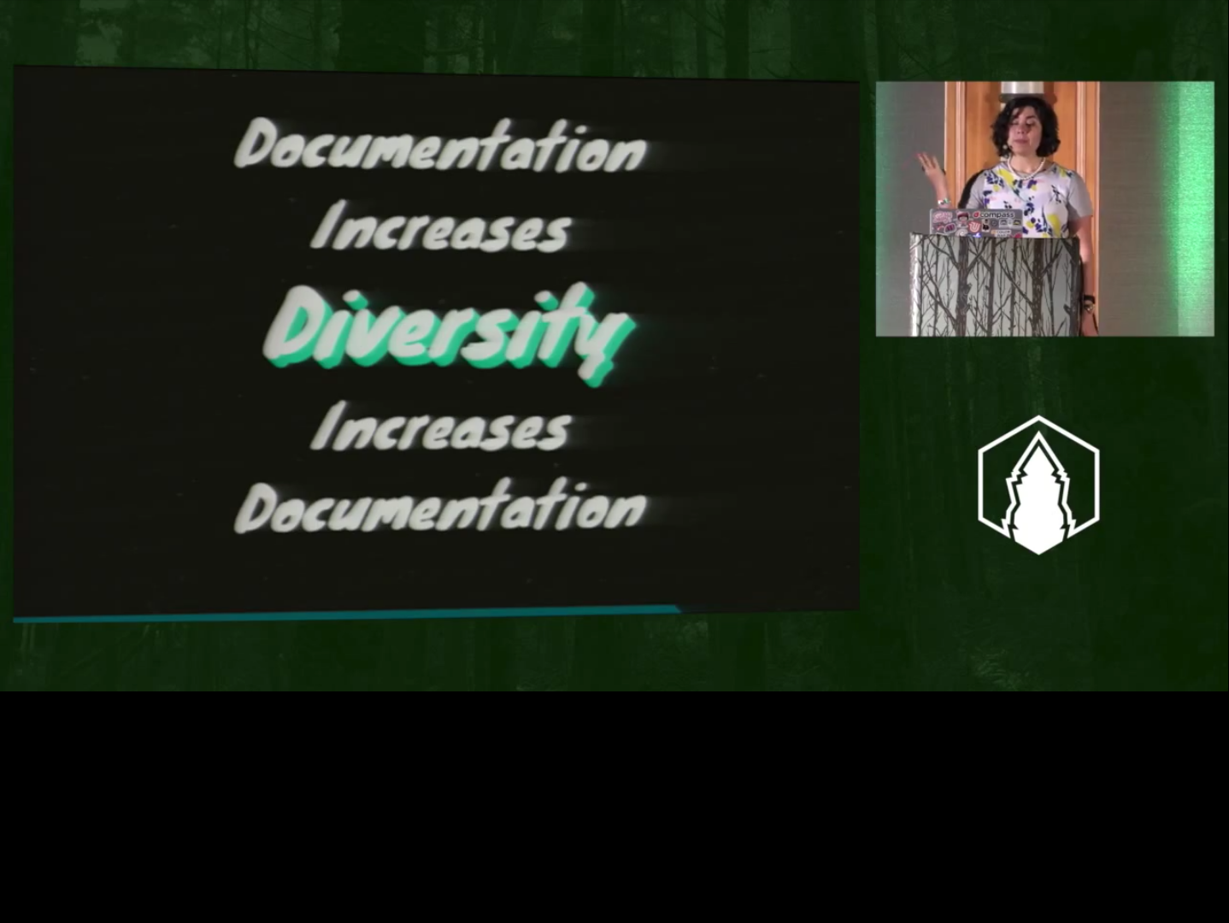
Una Kravets at CascadiaFest
Notes:
Una also mentioned that 100% of projects with at least 1 female contributor had a website/documentation/demo.
Documentation increases Diversity increases Documentation!
http://2015.cascadiajs.com/speakers/una-kravets

Slide 16
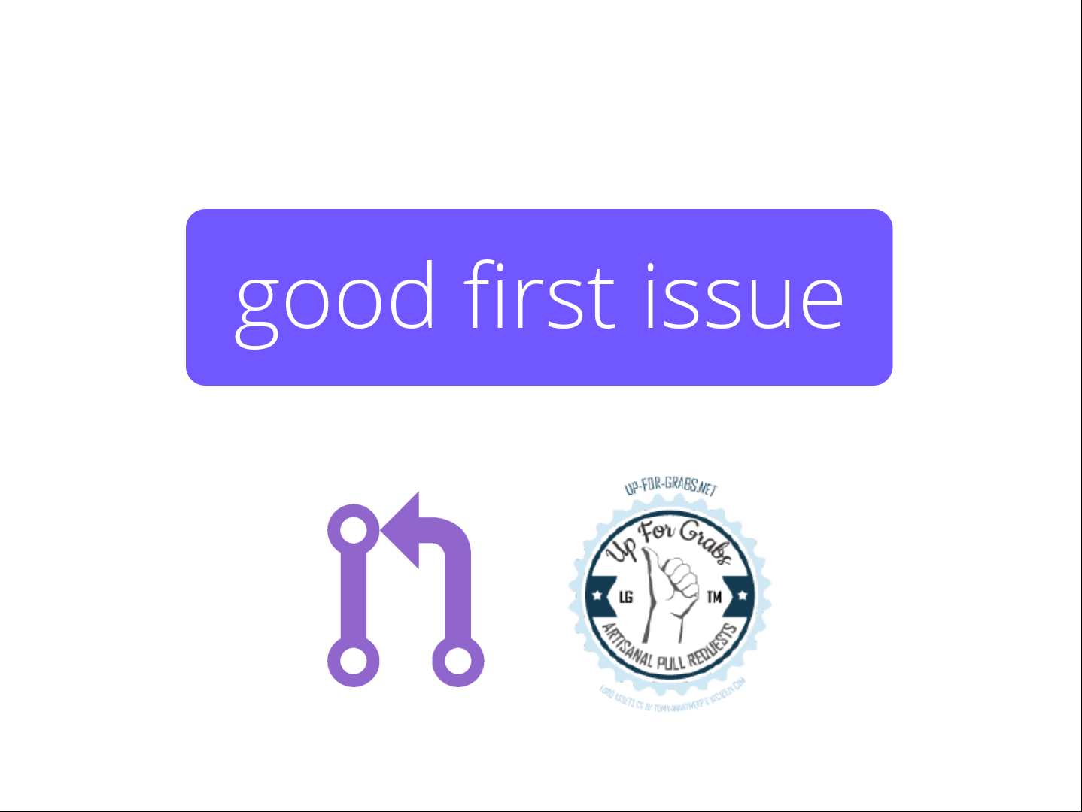

Slide 17
Women are more likely to seek out help directly (29% vs 13%) from people they already know well (22% vs 6%),
rather than ask for help from strangers in a public forum.
GitHub Open Source Survey 2017
Notes:
http://opensourcesurvey.org/2017/

Slide 18
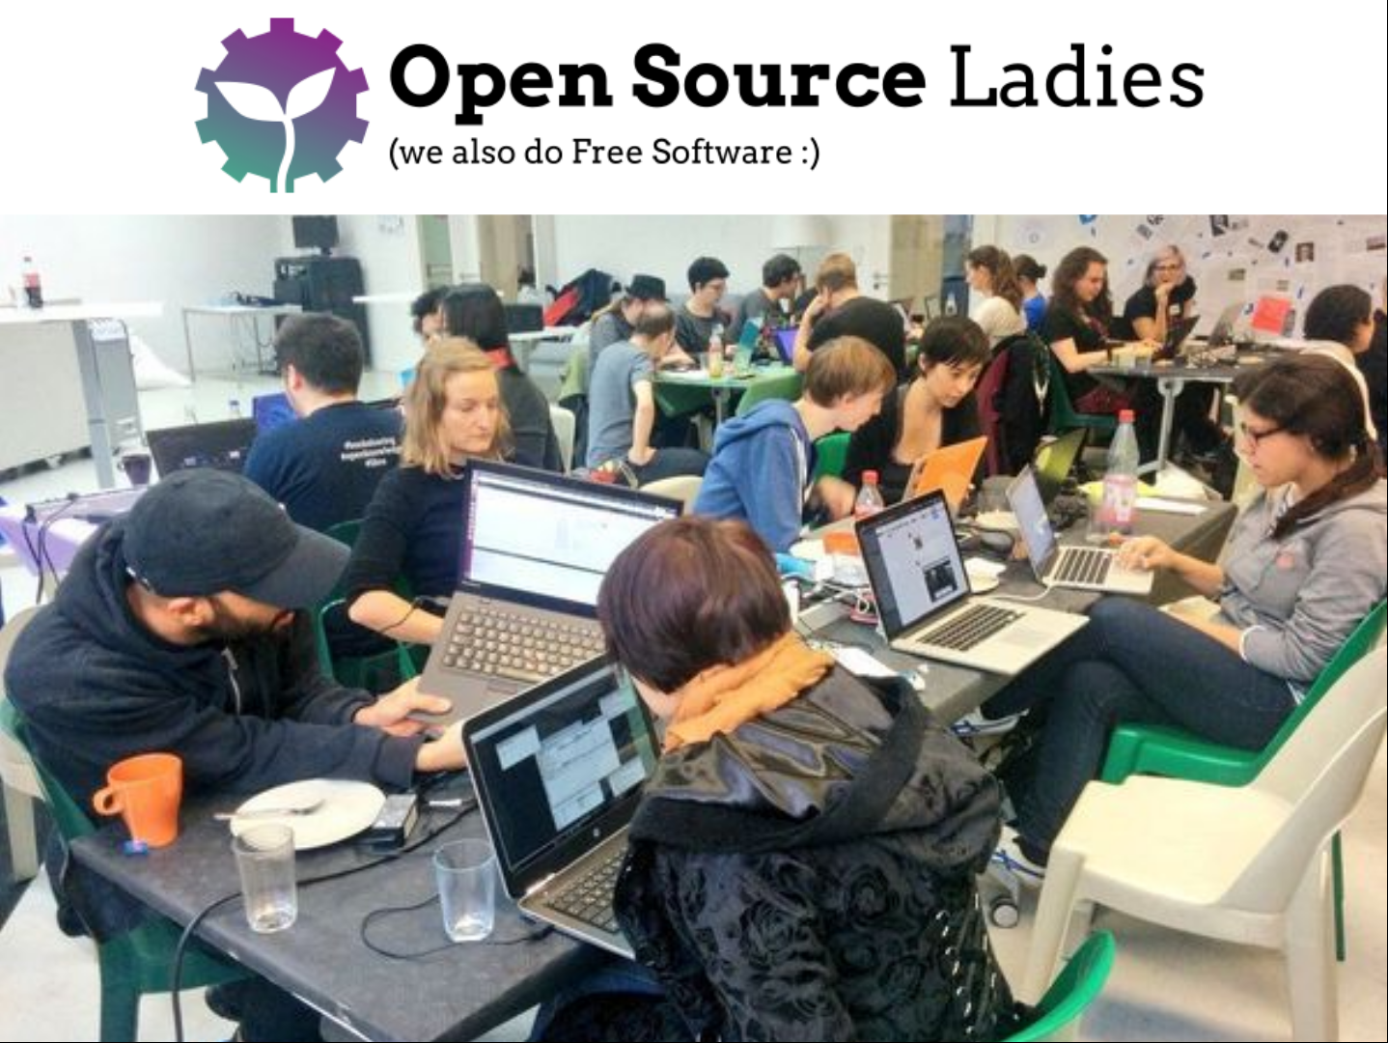
Notes:
Started as an open source hackathon @ Wikimedia Deutschland in October 2016
6 Projects, 1-3 mentors per project
Projekts: Mozilla Firefox, RIOT, MediaWiki, Wikidata, Inventaire, coala, Nextcloud, LibreOffice and Sourcefabric
35 women joined

Slide 19
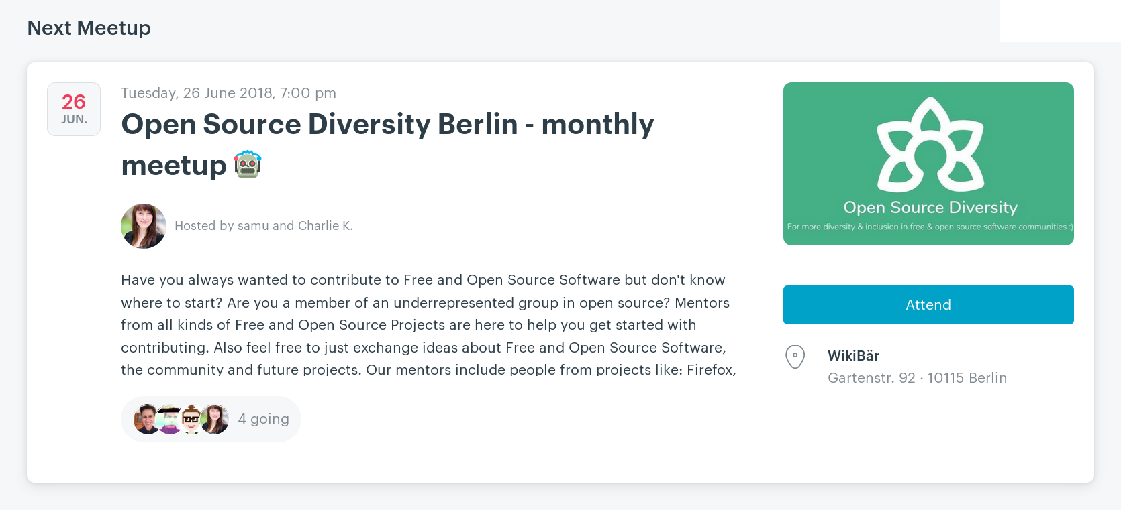

Slide 20
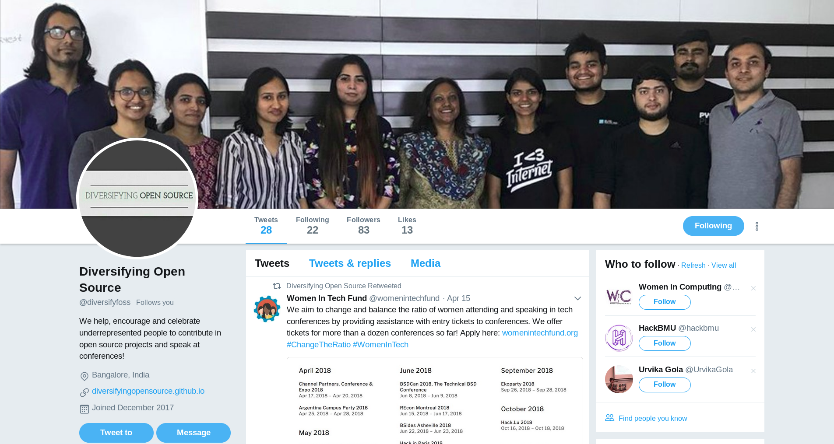

Slide 21
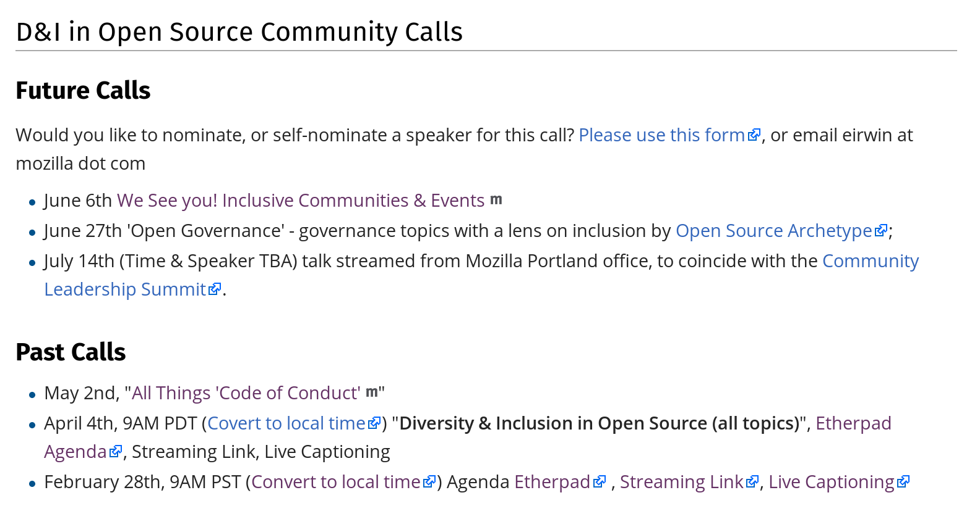
wiki.mozilla.org/Diversity_and_Inclusion_for_Communities_and_Contributors

Slide 22



Slide 23


Diversity Tickets

Slide 24
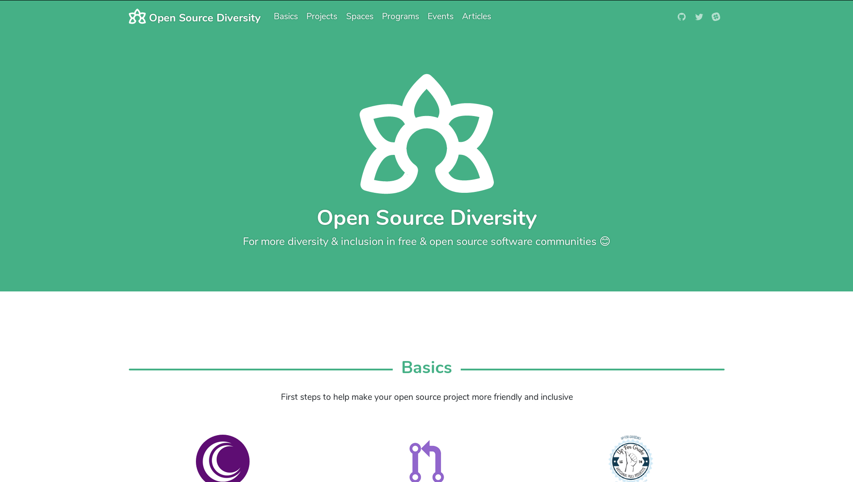

Slide 25
Thank you
& join the community!
opensourcediversity.org
@osdiversity #opensourcediversity

